Slide 1
CSCI 1301 Introduction to Computing and Programming
Summer 2015

Slide 2
Announcements
Course Calendar Changes
Project 3: due July 14th, 9PM.
This week: Cover sections 5.1 – 5.3
Read chapter 5. Read it twice.
Rubrics are updated through lab 3 and Project 1

Slide 3
Basics of Classes, Objects, and Methods
Chapter 5

Slide 4
Java Object-Oriented Programming
Java is an object-oriented programming language.
A program can be viewed as a collection of interacting objects.
Some objects might represent physical entities (automobiles); others might have no counterpart in the real world (Scanner).
Each object has a set of characteristics (attributes/data).
An object representing a student might have: first name, last name, 810-number, email-address, course-load.
The attribute values define the object’s state.
Each object has a set of actions it can perform (its behaviors).
Examples: add a course, drop a course.

Slide 5
Classes
An object in OOP is defined by a class.
Variables are used to define attributes.
Methods in the class define the objects behaviors.
A class is the blueprint/template for creating objects.
Every object belongs to a class.
Once the class is defined, multiple objects (instances of the class) can be created from it.
Essentially, we are creating our own data types!

Slide 6
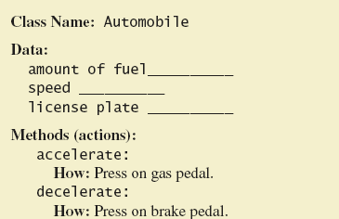
Class and Method Definitions
A class as a blueprint

Slide 7
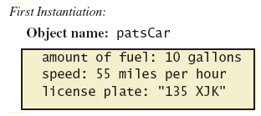
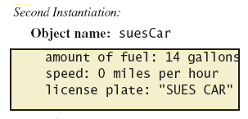
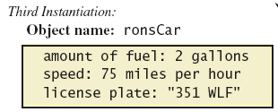
Class and Method Definitions
Objects that are instances of the class Automobile

Slide 8
Classes
To date, we haven’t used many of the object-oriented features in Java.
We have instantiated (created) objects from pre-defined classes
String, Scanner, Grid.
We have created “instances” of these classes.
But we haven’t defined our own classes yet.

Slide 9
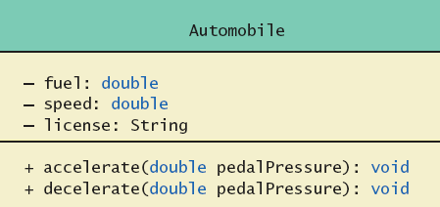
Class and Method Definitions
A class diagram of UML (Universal Modeling Language) is often used to represent classes.
Class Name
Data (Variables)
Methods
‘-’ means the member is “private”; ‘+’ means the member is “public”

Slide 10
Another Example
Student 1
first-name: "Mary"
last-name: "Feeney"
email: "mfeeny@shotz.edu"
…
Student 2
first-name: "Martin"
last-name: "Kosnowski"
email: "mk@shotz.edu"
…
Every object of the same class has the same attributes…
…but likely different values for the attributes.
The class (e.g. Student) defines a blueprint/schema for the objects in it.

Slide 11
Classes in Java
Java is an object oriented programming language.
A Java class definition might look something like this:
Class name
public class Student {
public String firstName;
public String lastName;
public String email;
public void addCourse(Course aCourse){
{
// (This is a comment);
// More code should go here.
}
public void printSchedule(){
{
// Again More code should go here.
}
// Etc. More code could go here.
}
Variables defining
attributes of the class
Class
body
Methods defining behaviors of the class. The first method takes an argument, which it uses to do its stuff.

Slide 12
Class Files and Programs
Every program we have created has consisted of a single Java class definition.
The source file ends in .java.
A program might consist of many such definitions.
The source files are compiled into .class files.
Classes can be compiled separately.
Existing class files can be used in new programs.
Files of the same program are typically bundled together in a common directory.
For instance, c:\csci1301\project4

Slide 13
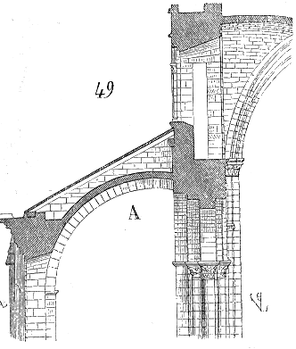
Why Bother?
As program size increases, it’s more difficult to maintain and keep free of errors.
We can’t effectively write everything in a single main method.
Alan Kay: Small programs are like dog houses, big ones are like cathedrals.
Object Oriented programming (OOP) adds structure to a program.
It promotes modularity, extensibility, reusability, maintainability.

Slide 14
public class Dog
{
public String name; // These 3 are instance variables.
public String breed; // Every instance of Dog will have values for them.
public int age; // The values will vary from instance to instance.
public void writeOutput()
{
System.out.println("Name: " + name);
System.out.println("Breed: " + breed);
System.out.println("Age in calendar years: " + age);
System.out.println("Age in human years: " + getAgeInHumanYears());
System.out.println();
}
public int getAgeInHumanYears()
{
int humanYears = 0;
if (age <= 2)
{
humanYears = age * 11;
}
else
{
humanYears = 22 + ((age-2) * 5);
}
return humanYears;
}}
The access modifier public means that other classes can access the variables and methods.
Using public is bad form; it exposes too much of the class.

Slide 15
Using a Class and Its Methods
public class DogDemo
{
public static void main(String[] args)
{
Dog balto = new Dog();
balto.name = "Balto";
balto.age = 8;
balto.breed = "Siberian Husky";
balto.writeOutput();
Dog scooby = new Dog();
scooby.name = "Scooby";
scooby.age = 42;
scooby.breed = "Great Dane";
System.out.println(scooby.name + " is a " + scooby.breed + ".");
System.out.print("He is " + scooby.age + " years old, or ");
int humanYears = scooby.getAgeInHumanYears();
System.out.println(humanYears + " in human years.");
}
}
Once the class is defined, we can create instances of it.
This is called instantiating an object.
Note the syntax:
Dog balto = new Dog();

Slide 16
Using a Class and Its Methods
public class DogDemo
{
public static void main(String[] args)
{
Dog balto;
balto = new Dog();
balto.name = "Balto";
balto.age = 8;
balto.breed = "Siberian Husky";
balto.writeOutput();
Dog scooby = new Dog();
scooby.name = "Scooby";
scooby.age = 42;
scooby.breed = "Great Dane";
System.out.println(scooby.name + " is a " + scooby.breed + ".");
System.out.print("He is " + scooby.age + " years old, or ");
int humanYears = scooby.getAgeInHumanYears();
System.out.println(humanYears + " in human years.");
}
}
balto and scooby are both variables declared to be of type Dog.
They are reference variables.
Each represents an instance of the class Dog.
Each has its own instance variables which can be set independently.

Slide 17
Methods: Syntax
The general form of a method declaration is given below.
The first line is the method header (or signature). Inside the brackets is the method body.
Parameters is a list of arguments; the values of the arguments can be used within the method.
public returnType methodName(Parameters)
{
//Statements;
}

Slide 18
Methods
Methods are "invoked" or "called” from the other classes or main.
Two kinds of Java methods
Those with return values.
Those without (return type void)
The writeOutput() method is a void method.
When called, the above method performs an action but returns no value.
public void writeOutput()
{
System.out.println("Name: " + name);
System.out.println("Breed: " + breed);
System.out.println("Age in calendar years: " + age);
System.out.println("Age in human years: " + getAgeInHumanYears());
System.out.println();
}

Slide 19
Invoking Methods
Dog balto = new Dog();
balto.name = "Balto";
balto.age = 8;
balto.breed = "Siberian Husky";
balto.writeOutput();
Note that this code occurs in the main method (in a separate class – not in Dog). We create an object of type Dog and then we can invoke its methods (writeOutput()).
To invoke an instance method:
The invocation begins with the object’s variable name,
then ‘.’ followed by the method name,
followed by parentheses (and possible arguments), and ending in a ‘;’.
Note: the method can only be called on objects of the class for which the method is defined. Called on a Dog Object!
Methods are defined within a class.

Slide 20
Methods with Return Values
A method that returns a non-void value can be used like a variable or value.
Dog scooby = new Dog();
scooby.name = "Scooby";
scooby.age = 42;
scooby.breed = "Great Dane";
int humanYears = scooby.getAgeInHumanYears();
System.out.println(humanYears + " in human years.");

Slide 21
Methods That Return a Value
public int getAgeInHumanYears()
{
int humanYears = 0;
if (age <= 2)
{
humanYears = age * 11;
}
else
{
humanYears = 22 + ((age-2) * 5);
}
return humanYears;
}
The method header declares the return type.
The last statement executed is a return statement.
Syntax: return value;
return can also be used in void methods (without a value).

Slide 22
Methods – What is the Return Type
Scanner.nextInt();
Scanner.nextDouble();
System.out.println(“Hello”);
“hello”.substring(0,3);
“hello”.charAt(1);
“hello”.equals(“world”);

Slide 23
Second Example – Species Class
Class designed to hold records of endangered species
View the class listing 5.3 class SpeciesFirstTry
Three instance variables, three methods
Will expand this class in the rest of the chapter
View demo class listing 5.4 class SpeciesFirstTryDemo
Given a SpeciesFirstTry class, we can write the Driver (Main) program.

